Slide 1
CHAPTER 1. MAMMALIAN HISTOLOGY
1.2. Digestive system
1.2.Vertical Section of tooth
T.Y.B.Sc. ZOOLOGY
SEMESTER V COURSE XIII
Histology, Pathology, Toxicology and Biostatistics

Slide 2
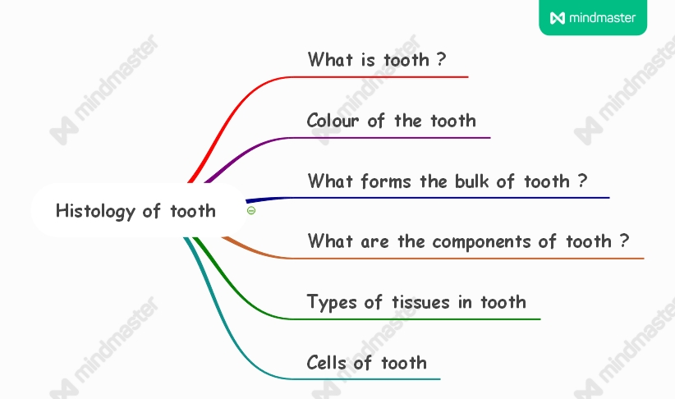

Slide 4
1.2. Digestive System : Vertical Section of Tooth
Mammalian tooth is made up of two components i.e. hard tissues and soft tissues. The hard components are enamel, Dentine and cementum
Soft tissue is tooth pulp.
The supporting tissues are peridontium, Gingiva, and alveolar bone.
Enamel
Hardest tissue; resistant to abrasion; less porous; contains fluorides.
Synthesized during developmental stages and does not regenerate.
Colour in young stages – Bluish white.
Colour in adult stages – yellowish .
2. Dentine
Hard calcified tissue forming crown and root of tooth.
Surrounds pulp cavity.
Produced by odontoblast cells.
Ectomesenchymal in origin

Slide 5
3. Cementum
Thin layer of mineralized tissue.
Covers the dentine
Connects the alveolar bone by periodontal ligaments.
Produced by cementoblast cells.
There are two types of cementum
Acellular- covers entire root surface
Cellular- found at the apex of root .

Slide 6
3. Soft tissues : Tooth Pulp
Contains 75% water and 25% organic matrix. Fills the dental cavity.
Comprised of loose connective tissue.
It is made up of pulpal fibroblasts and free cells like histiocytes,
plasma cells, antigen p[resenting cells and leucocytes.
Provides nourishment and support.
Also important in defense mechanism through immune cells.
4. Supporting tissues of the tooth
Periodontoum : Strong flexible connection of bones; it is dense connective tissue present between cementum and alveolar bone.
Gingiva (Gum): composed of lamina epithelialis made up of squamous epithelium and lamina propria made up of dense connective tissue. There are two type of gingiva i.e. free and attached gingiva.
Tooth Alveolus (Socket): Suppports and protects the teeth. Part of mandible or maxilla. Composed of compact lamellar bone and spongy bone.

Slide 7
THANK YOU !

